Slide 1


The Social Mission Metrics Initiative
Sonal Batra
Thomas Guterbock
Julie La Orban
Anushree Vichare
Leigh Anne Butler
Candice Chen
Toyese Oyememi
Ashley Darcy-Mahoney
Asefeh Faraz
Patricia Pittman

Slide 2
Social Mission Defined
“Social Mission is the contribution of a health professions school in its mission, programs, and the performance of its graduates, faculty, and leadership in advancing health equity and addressing the health disparities of the society in which it exists.”
Notes:
SMMI: A free system of metrics to assess the social mission of dental, medical, and nursing schools

Slide 3




The Social Mission Metrics Initiative
A free system of metrics to assess the social mission of dental, medical, and nursing schools
https://socialmissionmetrics.gwhwi.org/
Notes:
The Social Mission Metrics Initiative centers around the creation and use of metrics to measure social mission in dental, medical, and nursing schools across the United States. By providing school leaders with a tool to objectively assess the status of social mission at their school, the Initiative aims to advance the field of Social Mission measurement and enhance the national conversation around Social Mission in health professions education.​
SMMI was started at the Mullan Institute as a spinoff of a previous study that Fitz and Candice conducted. As the project grew, we contracted with the Center for Survey Research at the University of Virginia to manage survey distribution and conduct data analysis. The current work is funded by the Robert Wood Johnson Foundation, previous years included additional funding from HRSA.

Slide 4
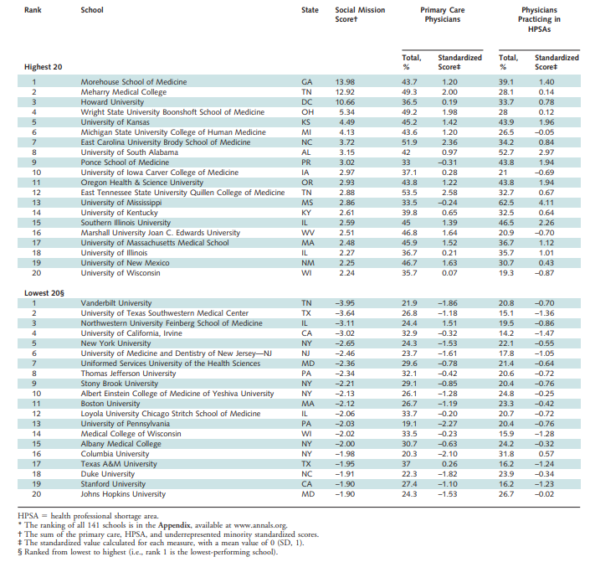
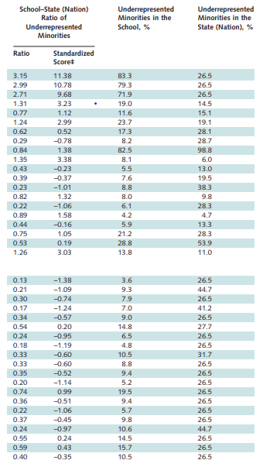

Slide 5
Outcomes
Rankings Paper
Structure/
Process
Social Mission Metrics Initiative
Notes:
Fitz – 1 minute
Rankings paper was outcomes focused and demonstrated significant variability in school performance (limited to medical schools)
Process measures do not exist
Current study seeks to establish those measures

Slide 6
SMMI History
2016
  Content Development
2017
  Survey Testing and Refinement
2018
  Development of Analytic Framework
2019
  National Self-Assessment Campaign
2020
  Impact Analysis, Validation
2021
  Survey Refinement, Strategic Planning
Notes:
SMMI started in 2016 with funding by the Robert Wood Johnson Foundation (RWJF)
Jointly funded by the Health Resources and Service Administration’s Bureau of Health Workforce in 2017
The first year involved the development and initial piloting of a questionnaire to measure social mission
Based on literature review, key informant interviews, and guidance of a National Advisory Committee
In 2017, the survey was field tested with sixty schools across three disciplines: medicine, nursing, and dentistry
Site visits were conducted to four participating schools, interviewing academic leaders, faculty, students, and staff to provide insight into how schools engaged with the survey and assessed for additional social mission activities
In 2019, all dental, medical, and a sub-set of nursing schools across the country were invited to complete the Social Mission Self-Assessment survey

Slide 7
Measures: Social Mission Areas
Curriculum
Extracurricular Activities
Targeted Education
Global Health
School Mission
Curriculum and Community Needs
Community Collaborations
Student Diversity
Faculty Diversity
Academic Leadership Diversity
Pipeline Programs
Student Training
Faculty Training
Student-run Clinics
Student Activism
Faculty Activism
Primary and Community-Based Care
Research
Notes:
With the guidance of a multidisciplinary National Advisory Committee, the survey was designed for schools to measure their social mission values, programs, and activities in 6 domains and 18 subdomains, called social mission “areas”
What is in the areas.

Slide 8
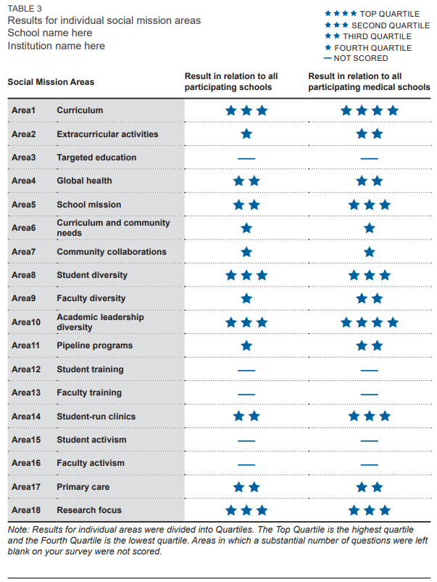
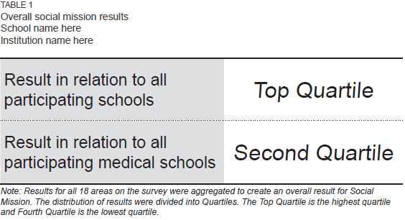
School Feedback
Notes:
Metrics allow schools to:
Understand the strengths and limitations of their social mission
Track their social mission engagement over time
See how their performance compares to national norms
6 domains and 18 subdomains, called social mission “areas”
A scoring system and analytic framework was developed based on stakeholder priorities – 2018 BFA Conference in Atlanta, SMM Priorities Survey
The scoring system and framework served as the basis for providing customized, confidential feedback to participating schools
Participating schools received two results, overall social mission results and results for each of the eighteen social mission areas in relation to all participating schools as well as in relation to their discipline. We used a graphical display of 1 to 4 stars to indicate results as being in the fourth quartile or in the top quartile.

Slide 9
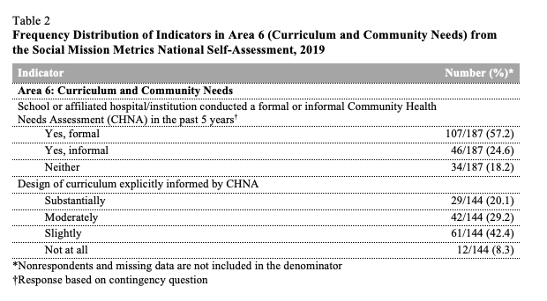
Aggregate Results
Notes:
The initiative resulted in a new data collection method to measure social mission
Findings provide a lens into the state of social mission at health professions schools across the nation and suggest a strong desire from schools to track education trends, gaps, and areas where strides are being made
Health professions schools must be able to measure and track their programs, activities and performance in social mission to address health equity and health disparities

Slide 10
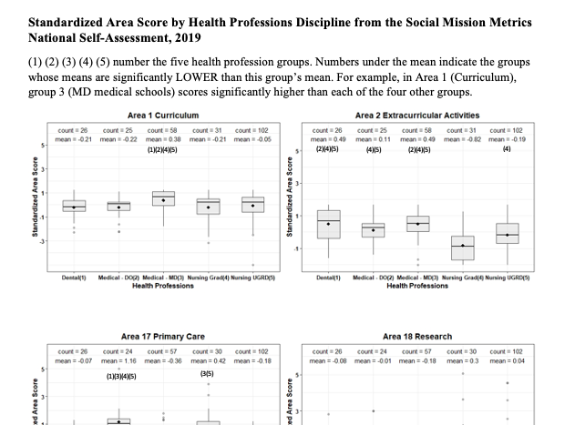
Notes:
Curriculum – Medical MD scored significantly higher than each of the other four groups; measures what is being taught within the curriculum, required IPE education for all students, the teaching of SDOH, health disparities, etc.
Extracurricular activities – Medical MD scored significantly higher; measures Service-learning/volunteer hours – required, how many hours, how many participate, Extracurricular time on health disparities/social determinants
Primary care – Medical Do scored significantly higher; measures school encouragement to enter primary care, grads practicing in FQHC, CHC, % entering primary care upon graduation
Research – Grad nursing schools did well; measures types of research engaged by the school including research in health equity and health disparity

Slide 11
External Validation
Performance on SMMI indicators and areas positively associated with
  Graduates working in general practice
    Curriculum
    Community Collaborations
  Graduates working in HPSAs
    Curriculum
    Faculty Activism
  Graduates working in Rural Practice
    School Mission and Strategic Plan
  Graduates accepting Medicaid
    Curriculum alignment with community needs
Data: 2019 American Medical Association Data + 2019 American Dental Association Data
Sample: 63 Medical Schools, 25 Dental Schools

Slide 12
Survey Revisions
Priorities Surveys
Variance explained in factor analysis
Discriminant power in cluster analysis
Response rate, reporting burden
Removing redundancies, combining similar questions
External Outcomes

Slide 13
SMMI Impact on Schools
Sharing with stakeholders
Justification for current efforts
Request for additional support
Data tracking
Internal collaborations
Repeat surveys
Resources for improvement
Best Practices
Learning collaboratives/“Buddy” system

Slide 14
HWRC Projects
Understanding Stakeholder Social Mission Priorities (19-20)
Understanding the Impact of COVID-19 on Medical School Pathway Programs (20-21)
Medical School Social Mission association with Residency Systems-Based Practice Performance (21-22)
Social Mission in Health Professions Accreditation (19-20)

Slide 15
Accreditation
Accrediting Body | Curricu-lum | Ext. Activ-ities | Targeted Educ-ation | Global Health | School Mission | Curricu-lum & Comm-unity | Comm-unity Collab-orations | Student Diversity | Faculty Diversity | Leade-rship Diversity | Pipeline | Student Training | Faculty Training | Student-run Clinics | Student Activism | Faculty Activism​ | Primary Care​ | Research Focus ​
ACEN | Yes | - | - | - | - | - | Yes | - | - | - | - | Yes | - | - | - | - | - | -
ACPE | Yes | - | Yes | - | - | - | - | Yes | - | - | - | Yes | - | - | - | Yes | - | -
ARC-PA | Yes | - | Yes | - | - | - | - | Yes | Yes | - | - | Yes | - | - | - | - | Yes | -
CACMS | Yes | Yes | Yes | - | Yes | - | - | Yes | Yes | Yes | - | Yes | - | - | - | - | Yes | -
CCNE | Yes | - | - | - | - | Yes | - | - | - | - | - | Yes | - | - | - | - | - | -
CNEA | Yes | - | - | - | - | Yes | Yes | - | Yes | - | - | Yes | - | - | - | - | - | -
COCA | Yes | - | - | - | - | - | - | Yes | Yes | Yes | - | Yes | Yes | - | - | - | Yes | -
CODA | Yes | Yes | Yes | - | - | - | - | Yes | Yes | - | - | Yes | - | - | - | - | Yes | -
LCME | Yes | Yes | - | - | - | - | - | Yes | Yes | Yes | Yes | Yes | - | - | - | - | - | -

Slide 16
Next Steps
Fuel the conversation
Stimulate interprofessional engagement
Provide benchmarks and learning opportunities
Promote research on social mission and its measurement
Convening, publication, comparisons, global collaborations, accreditation
Partnerships with students, communities, prof associations
Repeat surveys, best practices, Learning collaboratives
Understand impact on health equity, logic model
Notes:
By providing school leaders with a tool to objectively assess the status of social mission at their school

