Slide 1
New York Resident Exit Survey
Presented by: David Armstrong, PhD
  Project Director
  Center for Health Workforce Studies
  School of Public Health | University at Albany, SUNY
  dparmstrong@albany.edu
September 21, 2021

Slide 2
Overview
Who do we survey?
What do we ask?
What does the survey tell us?
How do we share information from the survey?
How does the survey inform health workforce planning?
Notes:
Today I want to talk to you about our New York Resident Exit Survey which we conduct on an annual basis. I intend to answer several questions about the survey, including such things as:

Slide 3
Graduate Medical Education (GME) in New York
New York State trains the largest number of physicians in the nation
13% of all the physicians in the US were trained in a New York GME program
Currently, there are more than 1,300 GME programs in New York and 18,000 residents in training
Conducted annually since 1998 (except for 2004, 2006, and 2020)
Notes:
But first, I would like to provide you some background on graduate medical education in New York.

Slide 4
Who Do We Survey?
The survey is completed by all residents and fellows who are completing a training program in New York, EXCEPT for the following:
  Preliminary year residents
  Transitional year residents
  Dental residents
  Podiatric residents
More than 5,000 residents and fellows are surveyed annually

Slide 5
Exit Survey Administration
Rely on the assistance of teaching hospitals throughout the state
60 primary contacts located at hospitals in New York
  GME Directors and Administrators
  Program Directors
  Designated Institutional Officials (DIOs)
Key Dates (year long process)
  February: Ask primary contacts to update program information
  April: Mail surveys to primary contacts
  September: Finish collecting surveys
  October: Begin processing data and preparing reports

Slide 6
What Do We Ask?
We collect information on a variety of topics including:
  Demographic characteristics
  Medical education and training
  Education debt
  Upcoming practice characteristics
  Job market experiences
  Expected income

Slide 7
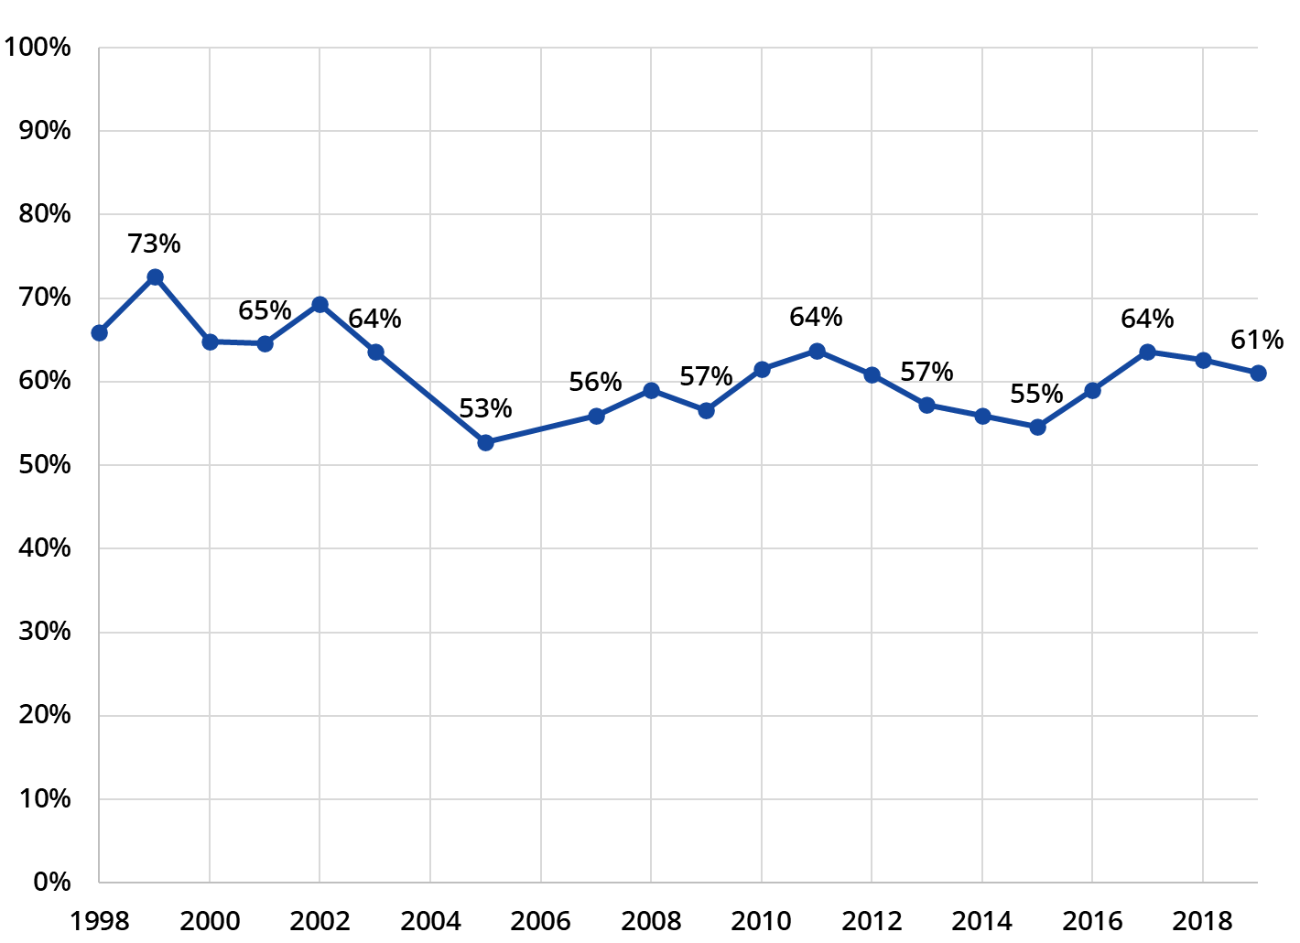
Response Rate by Year
Since 1998, 60,892 out of 99,687 physicians have completed the survey
Overall Response Rate: 61%

Slide 8
What Does the Survey Tell Us?
The Exit Survey allows us to monitor trends in GME and address important topics that may arise

Slide 9
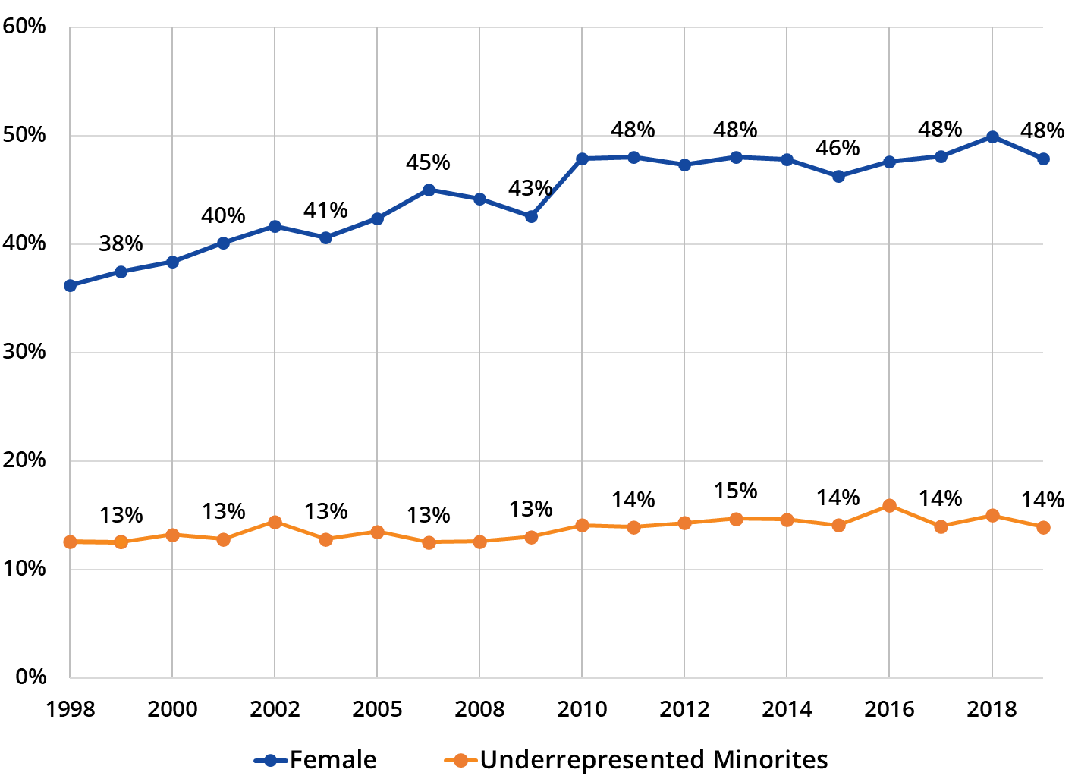
Gender and Racial/Ethnic Diversity in GME
Notes:
For example, the exit survey allows us to monitor….

Slide 10
Monitoring Trends in GME
The in-state retention of residents and fellows after completing training
The relative job market demand of different physician specialties
The gender pay gap in starting physician income
Notes:
We also monitor other trends in GME outcomes, including…

Slide 11
The Exit Survey Can Also Address Current Issues
A series of questions related to the COVID-19 pandemic was added to the 2021 survey
The questions addressed the impact of COVID-19 on training and the job market for new physicians

Slide 12
How Do We Share Information From the Survey?
Annual Reports and Research Briefs
  2018 New York Residency Training Outcomes: A Summary of Responses to the 2018 New York Resident Exit Survey
  Gender Pay Gaps Widen for Newly Trained Physicians
Conference Presentations
  AAMC Health Workforce Research Conference
  AcademyHealth Annual Research Meeting
NY GME Data Dashboard: https://nygme.chwsny.org/

Slide 13
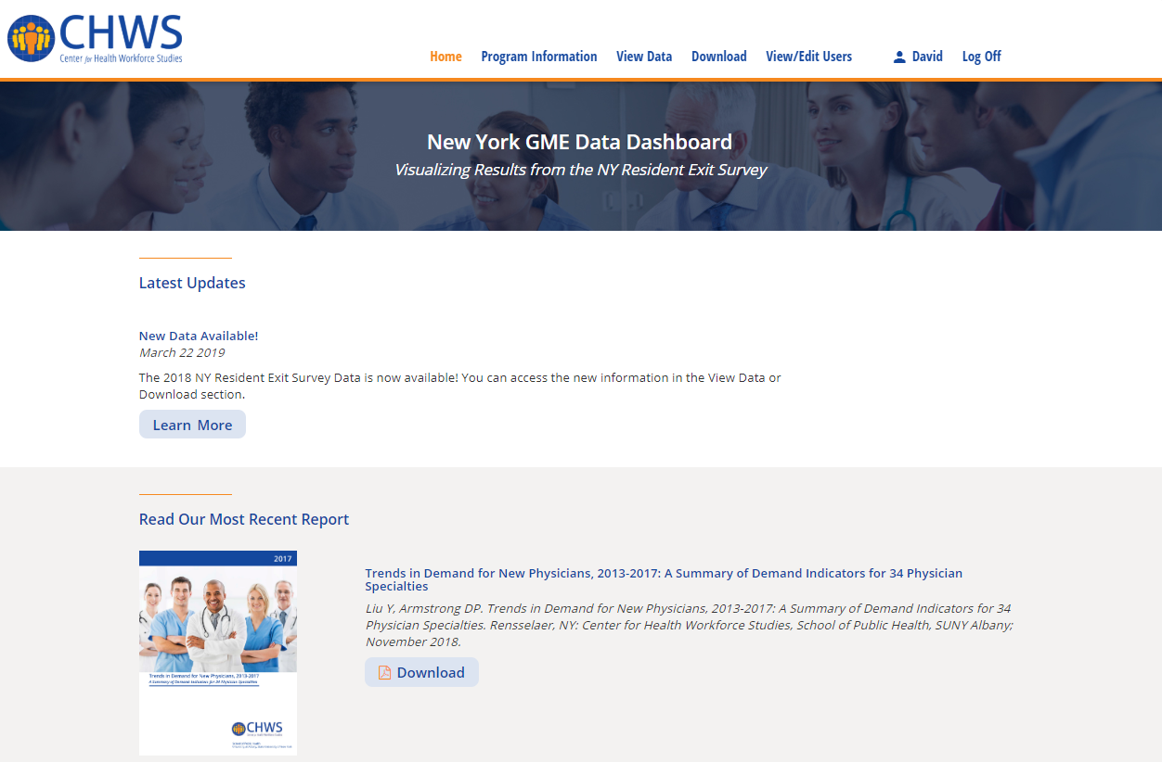

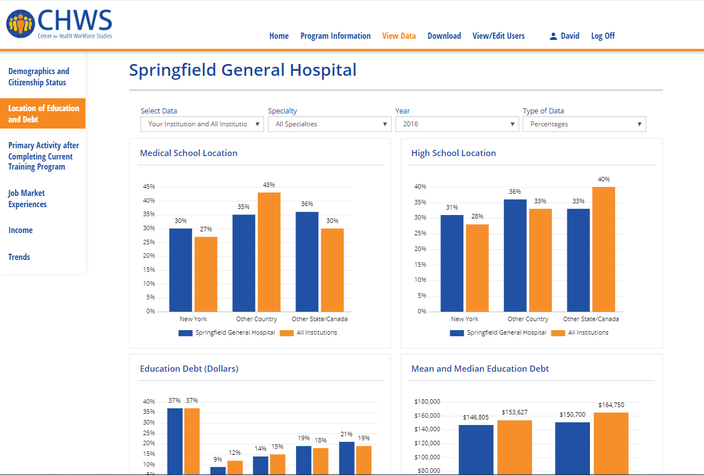
Notes:
The NY GME Data Dashboard website can be accessed by the general public and hospitals that participate in the survey. On the site you can download reports and view data on a variety of topics by year and specialty. If you are a member of a participating institution, you may log in to the site and view and download your institution’s specific data.

Slide 14
Health Workforce Planning
The Exit Survey is a valuable tool for health workforce planning
The survey allows you to monitor important trends and address pressing issues
The information gathered from the survey can be used to make informed policy decisions on a variety of topics, including:
  Diversity
  COVID-19
Notes:
including health workforce diversity and the impact of COVID-19 on health professions education, among others.

Slide 15



Contact Information
For more information, please email me at: dparmstrong@albany.edu
Visit us at:
@CHWS_NY
@Centerforhealthworkforcestudies
/company/center-for-health-workforce-studies
www.chwsny.org
Notes:
Now for those of you who have more questions, or are interested in developing your own survey, please email me at ….. I’m always happy to talk. Thanks for watching!

