Slide 1


HWTAC Webinar Series
NP Research Using the NSSRN

Slide 2
Nursing Research Using the 2018 National Sample Survey of Registered Nurses (NSSRN)
Session 2: January 21st, 3pm EST
-NP Research Using the NSSRN
David I Auerbach, PhD
Jeongyoung Park, PhD
Session 3: February 18th, 3pm EST
-RN Research Using the NSSRN
Susan Skillman, MS
Esita Patel, PhD, RN
Joanne Spetz, PhD

Slide 3



Peter I Buerhaus,
PhD, RN, FAAN, FAANP(h)
Moderator
David I Auerbach, PhD Presenter
Jeongyoung Park, PhD Presenter
Center for Interdisciplinary Health Workforce Studies, Montana State University College of Nursing
George Washington University School of Nursing
Center for Interdisciplinary Health Workforce Studies, Montana State University College of Nursing

Slide 4
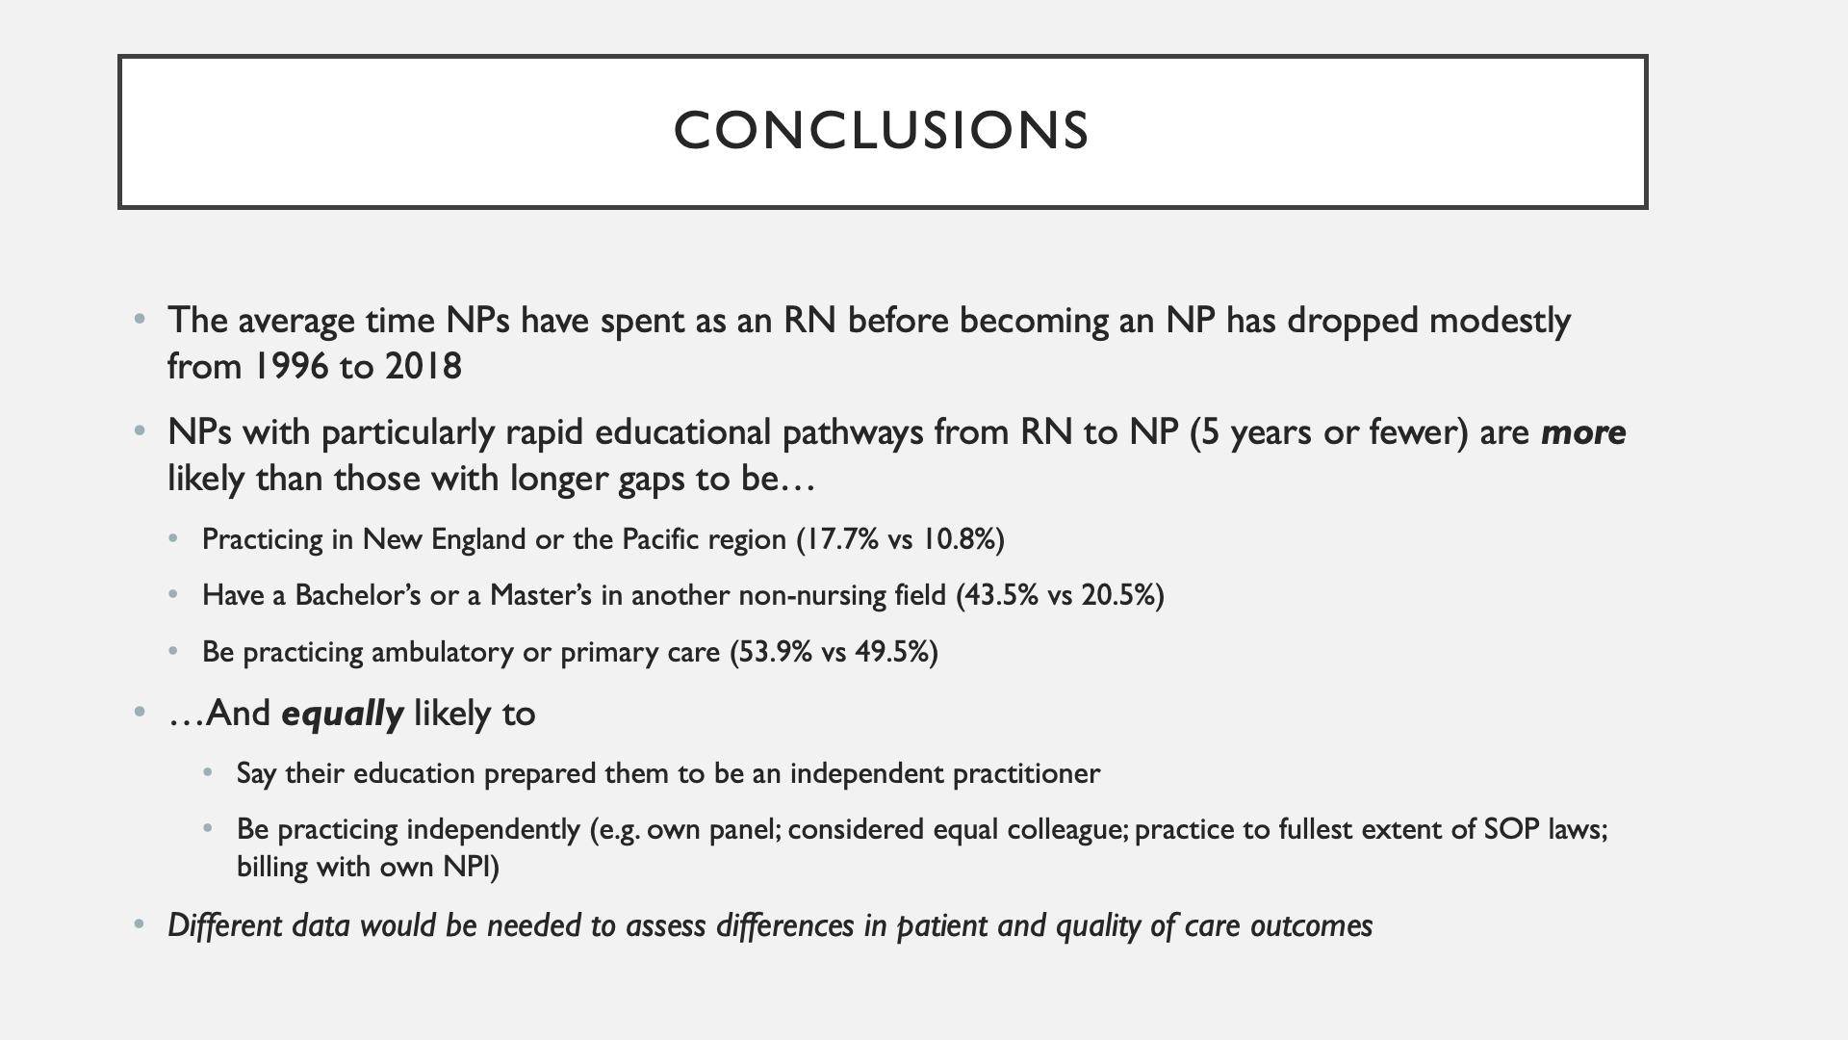
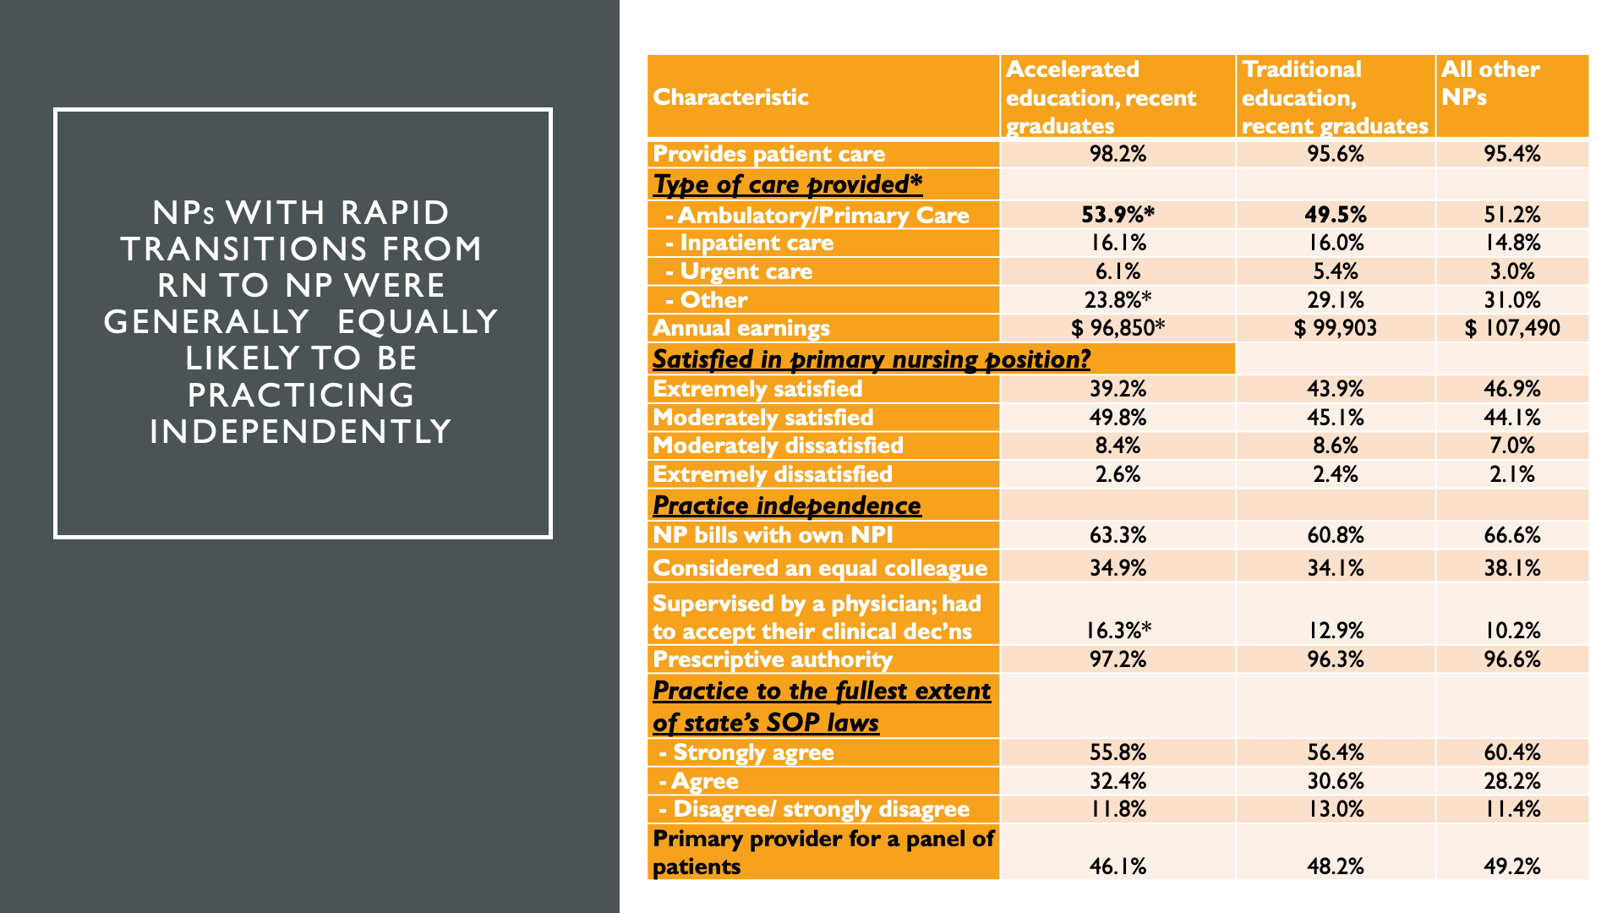
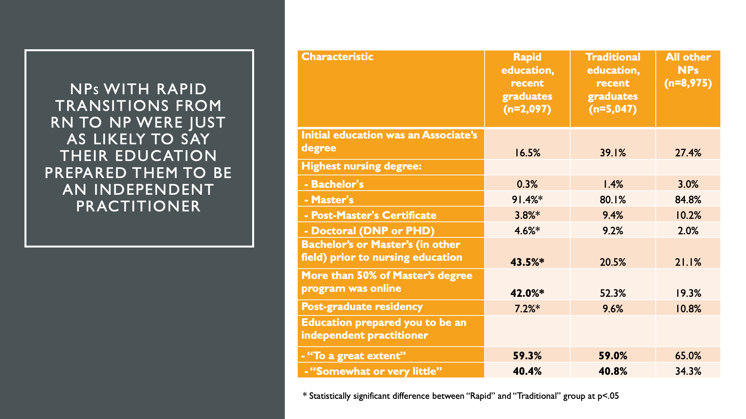
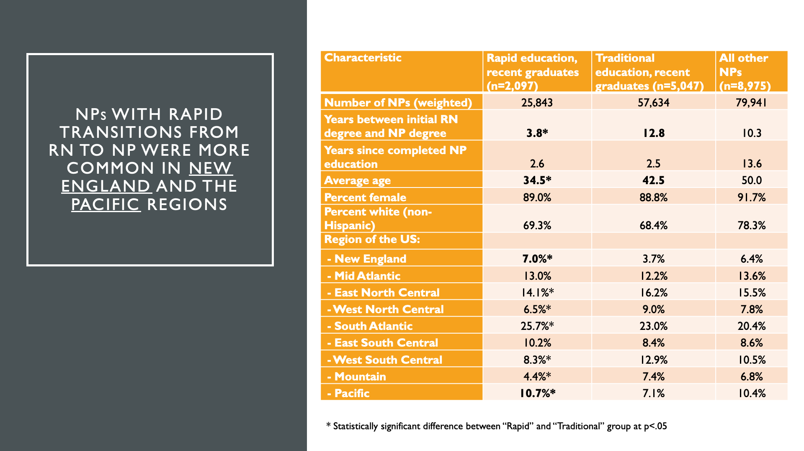
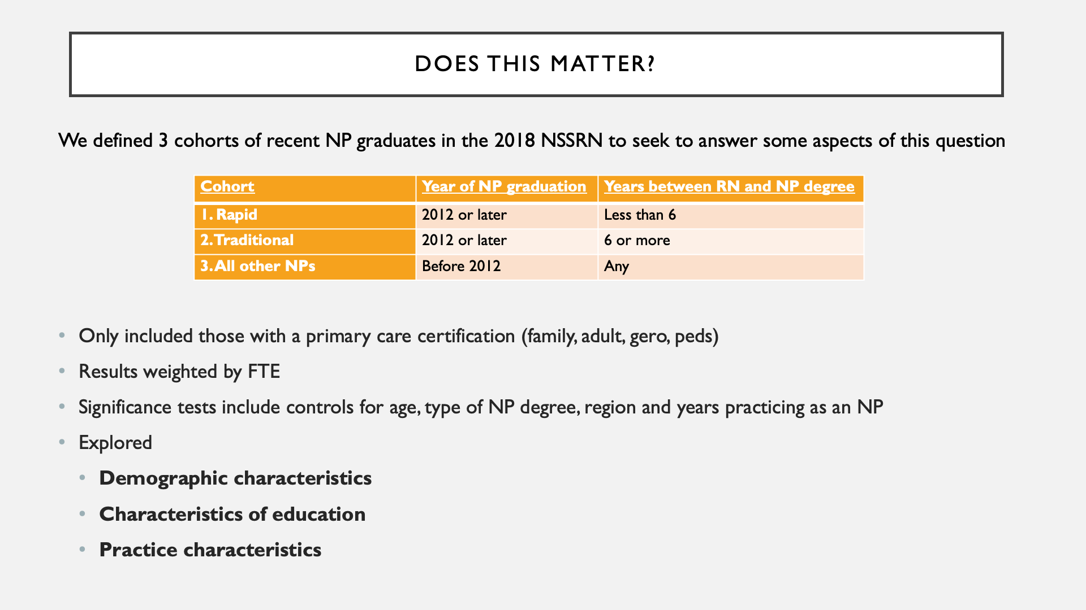
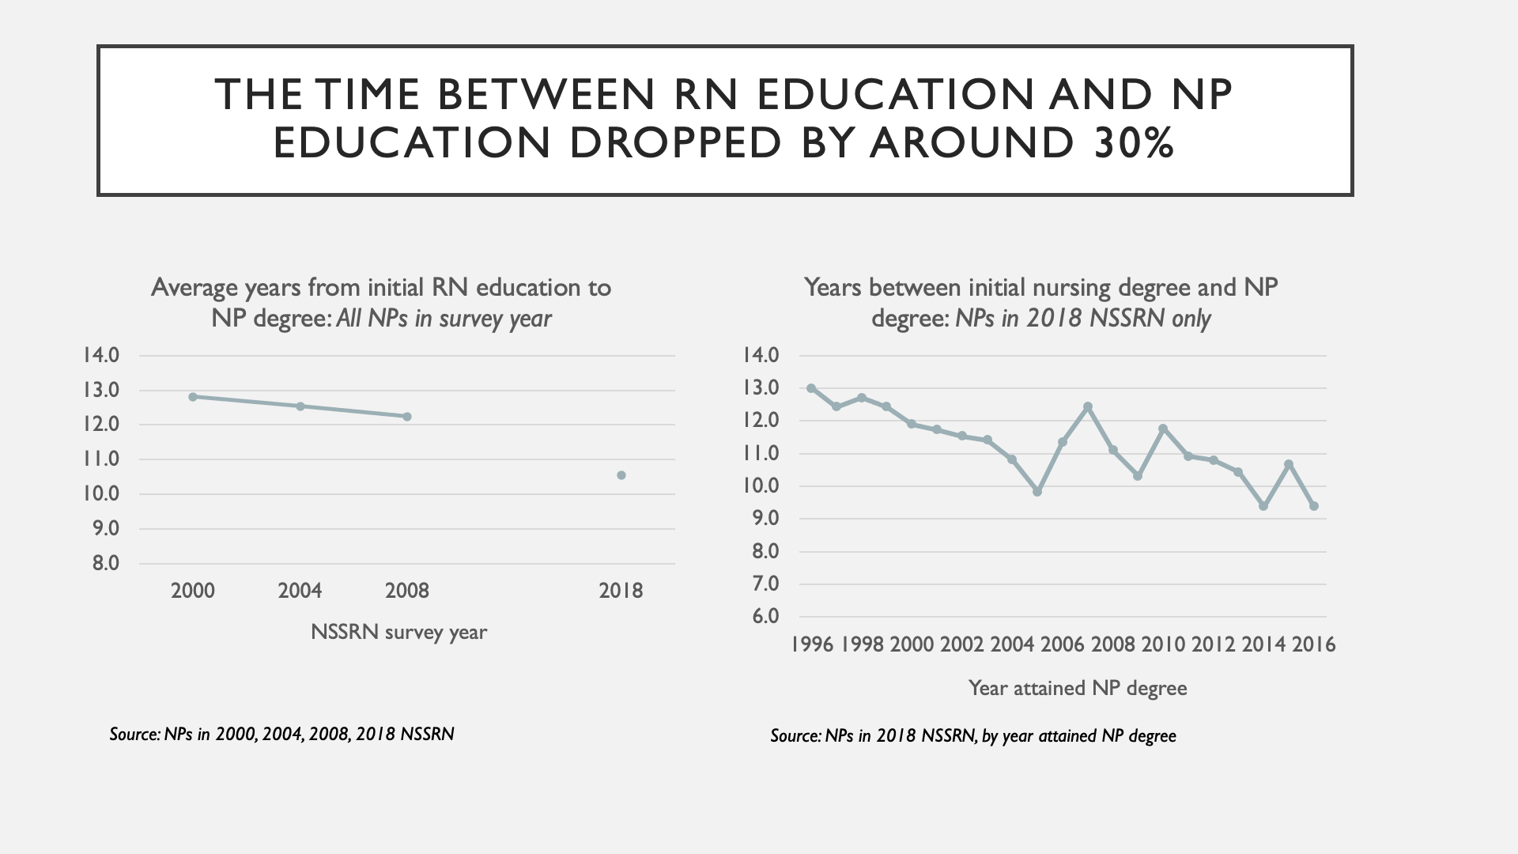
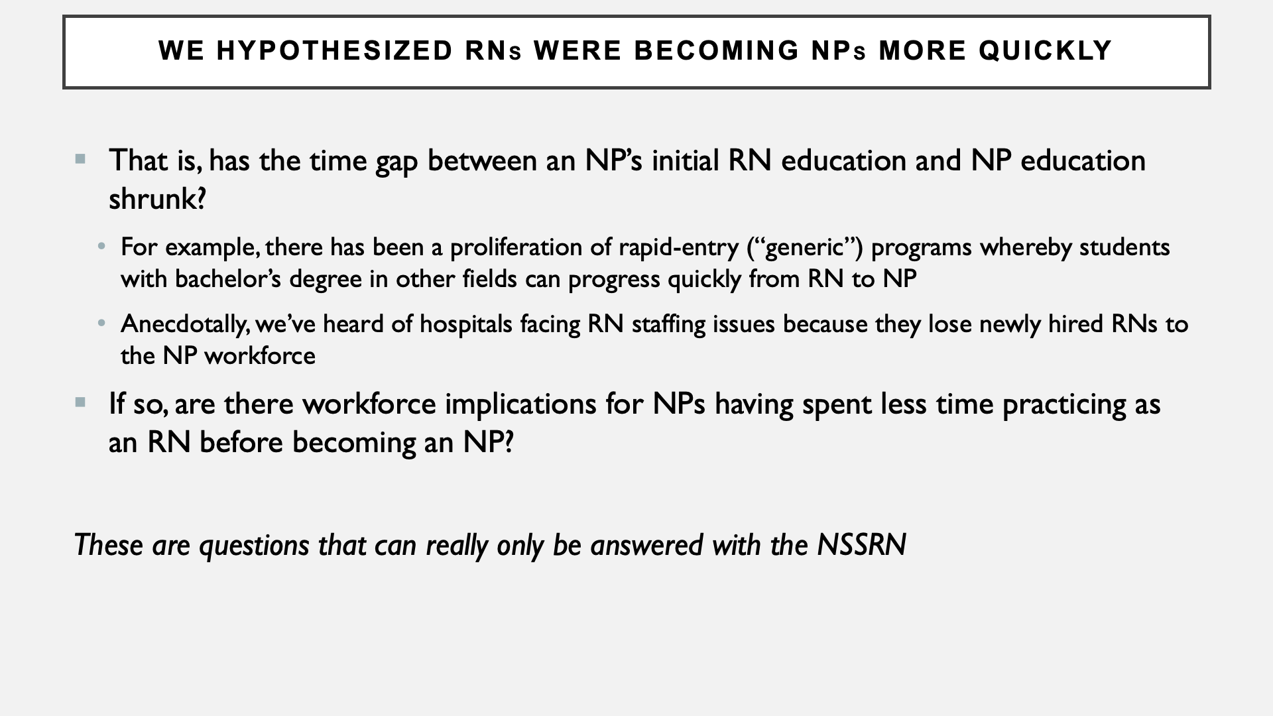
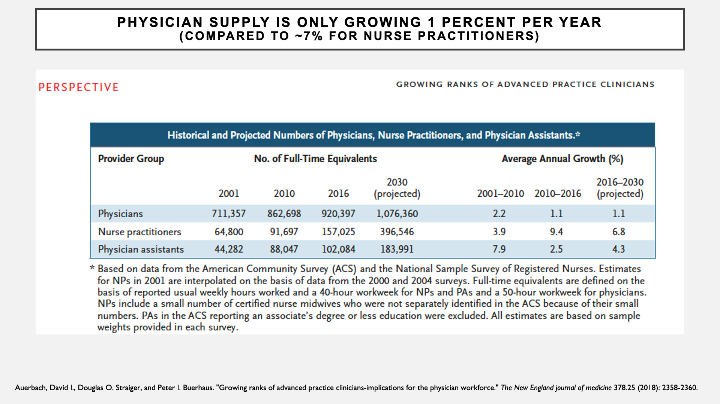
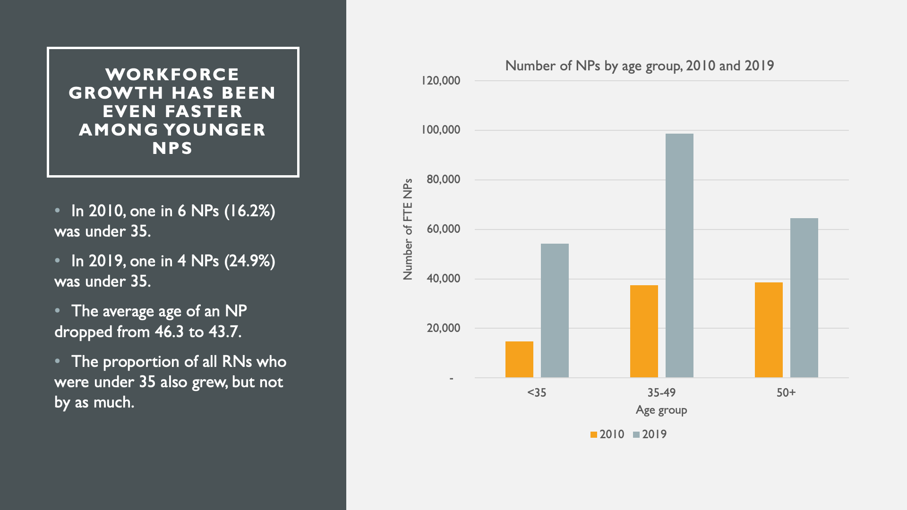
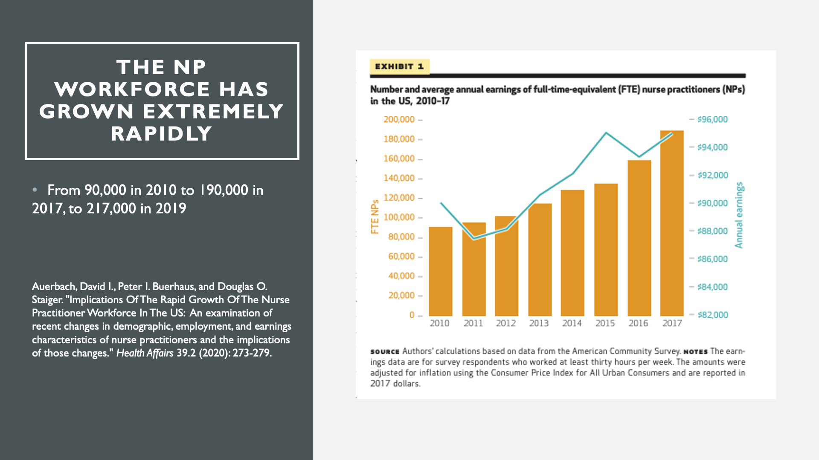


Slide 15
Nurse Practitioner Residency or Fellowship Programs:
Outcomes Reported in NSSRN
Jeongyoung Park, PhD
Asefeh Faraz Covelli, PhD, APRN, FNP-BC
Patricia Pittman, PhD
January 21, 2021

Slide 16
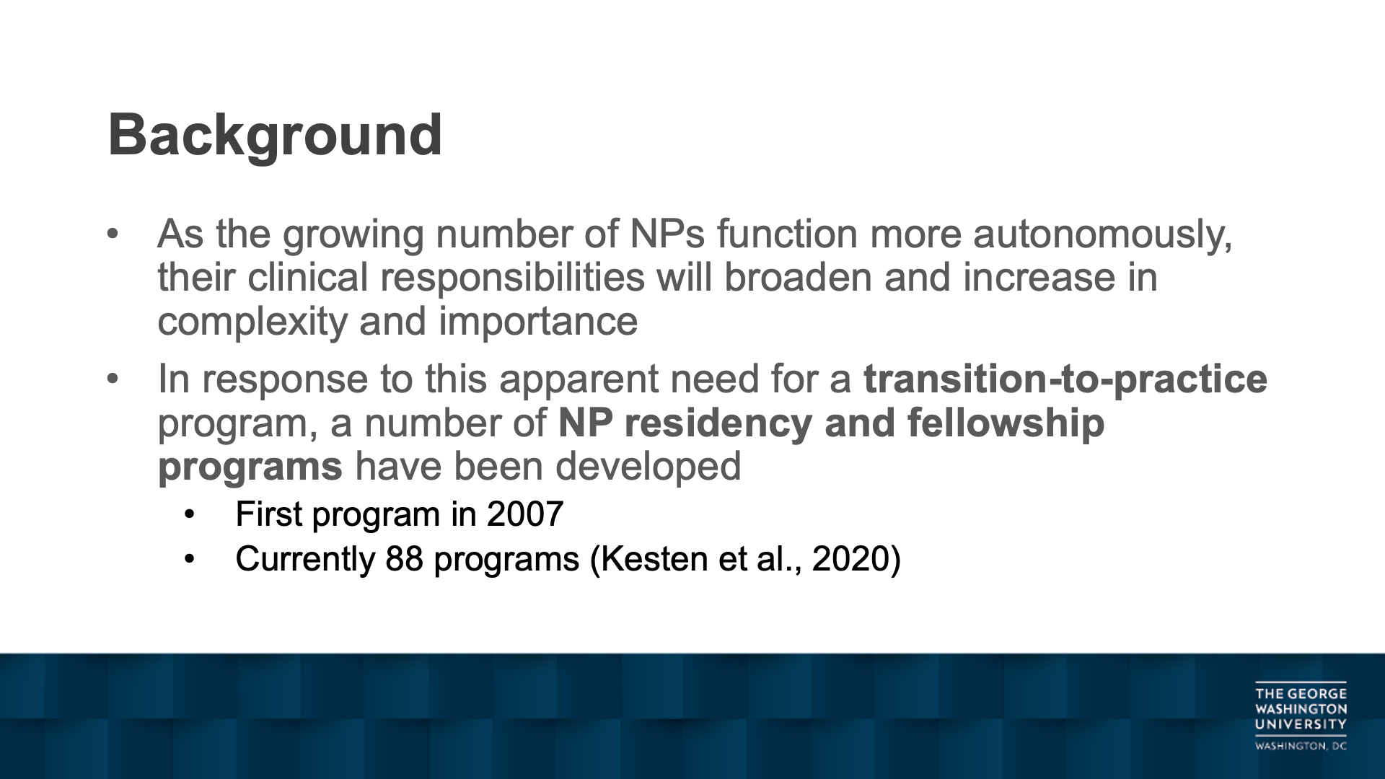
Background
As the growing number of NPs function more autonomously, their clinical responsibilities will broaden and increase in complexity and importance
In response to this apparent need for a transition-to-practice program, a number of NP residency and fellowship programs have been developed
  First program in 2007
  Currently 88 programs (Kesten et al., 2020)

Slide 17
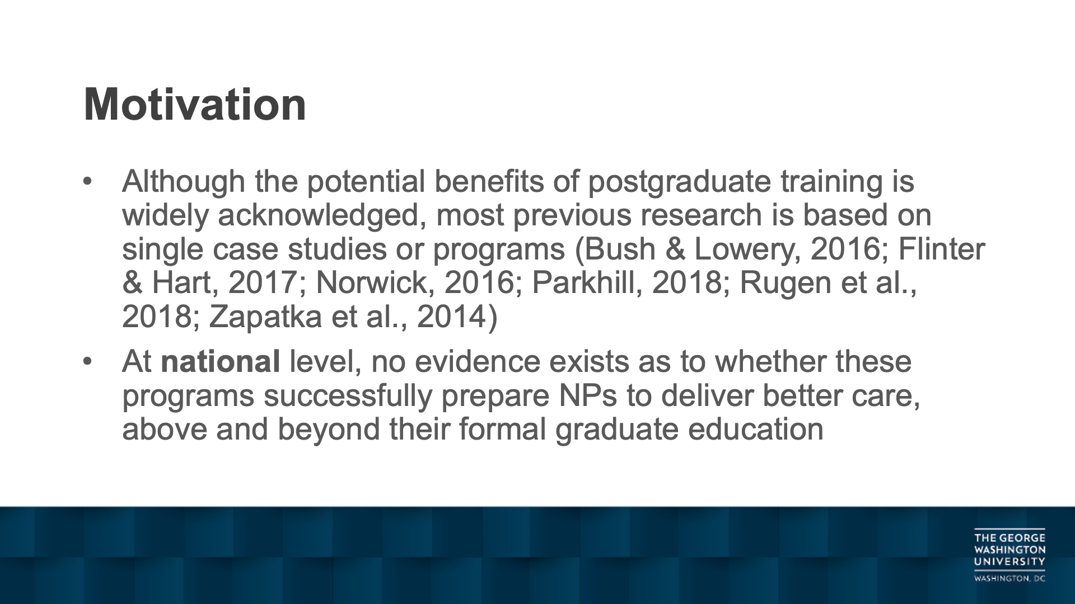
Motivation
Although the potential benefits of postgraduate training is widely acknowledged, most previous research is based on single case studies or programs (Bush & Lowery, 2016; Flinter & Hart, 2017; Norwick, 2016; Parkhill, 2018; Rugen et al., 2018; Zapatka et al., 2014)
At national level, no evidence exists as to whether these programs successfully prepare NPs to deliver better care, above and beyond their formal graduate education

Slide 18
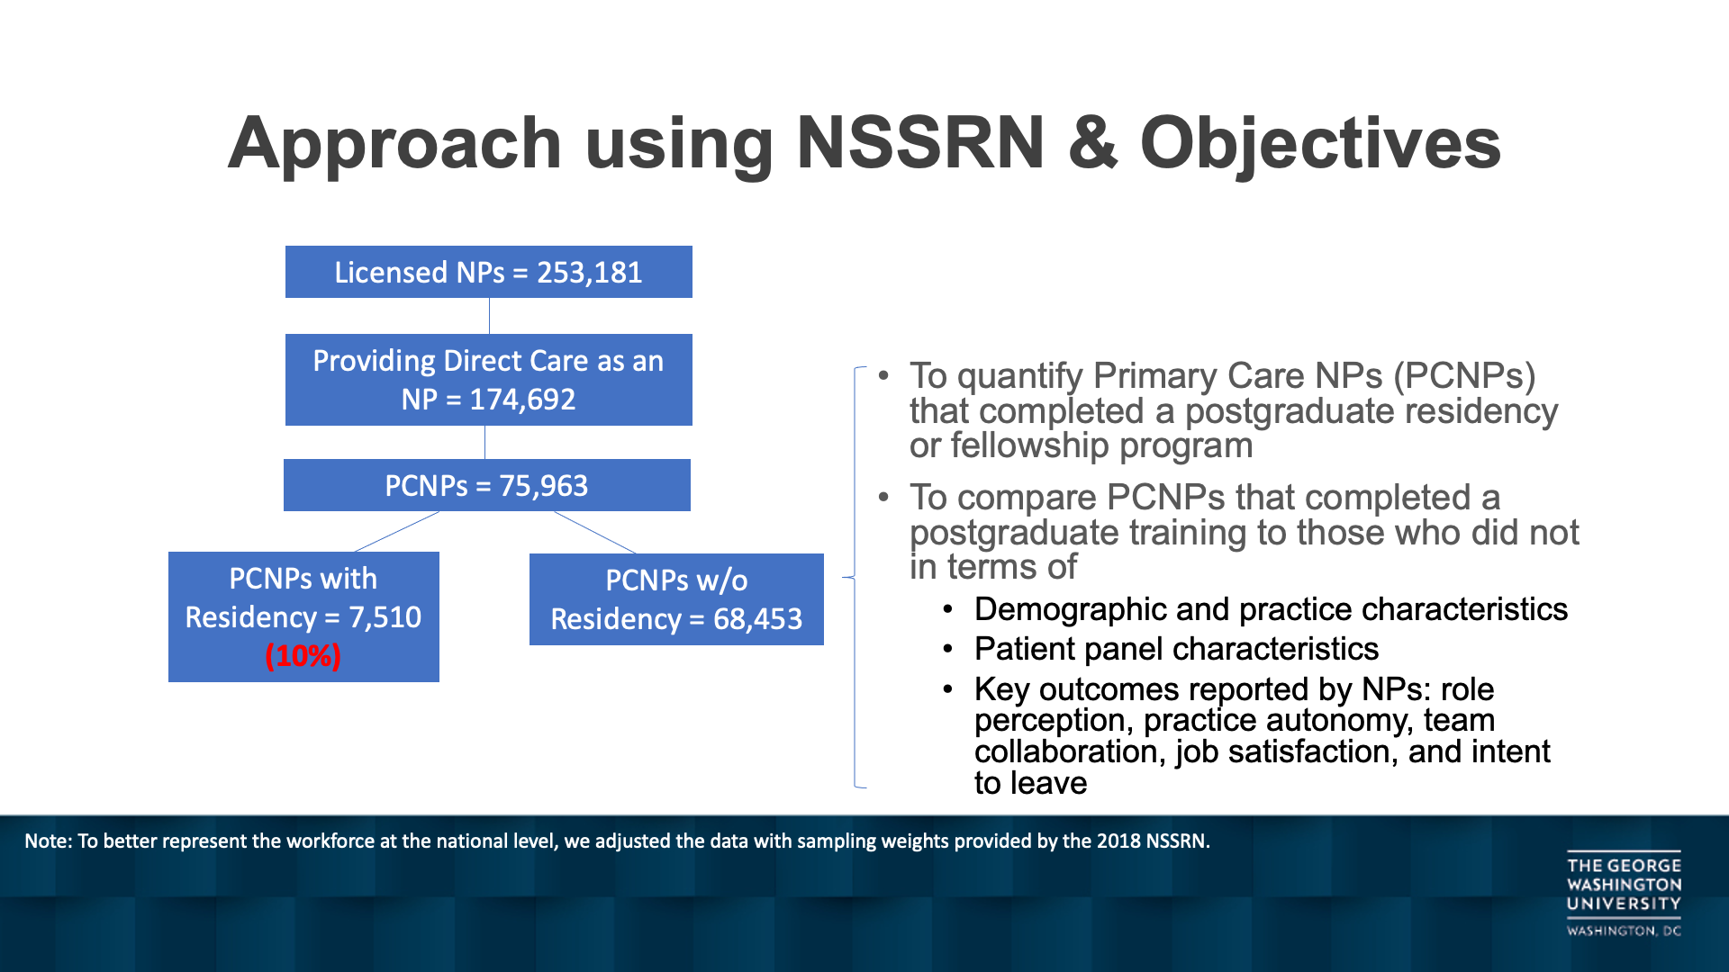
Approach using NSSRN & Objectives
Licensed NPs = 253,181
Providing Direct Care as an NP = 174,692
To quantify Primary Care NPs (PCNPs) that completed a postgraduate residency or fellowship program
To compare PCNPs that completed a postgraduate training to those who did not in terms of
  Demographic and practice characteristics
  Patient panel characteristics
  Key outcomes reported by NPs: role perception, practice autonomy, team collaboration, job satisfaction, and intent to leave
PCNPs = 75,963
PCNPs with Residency = 7,510 (10%)
PCNPs w/o Residency = 68,453
Note: To better represent the workforce at the national level, we adjusted the data with sampling weights provided by the 2018 NSSRN.

Slide 19
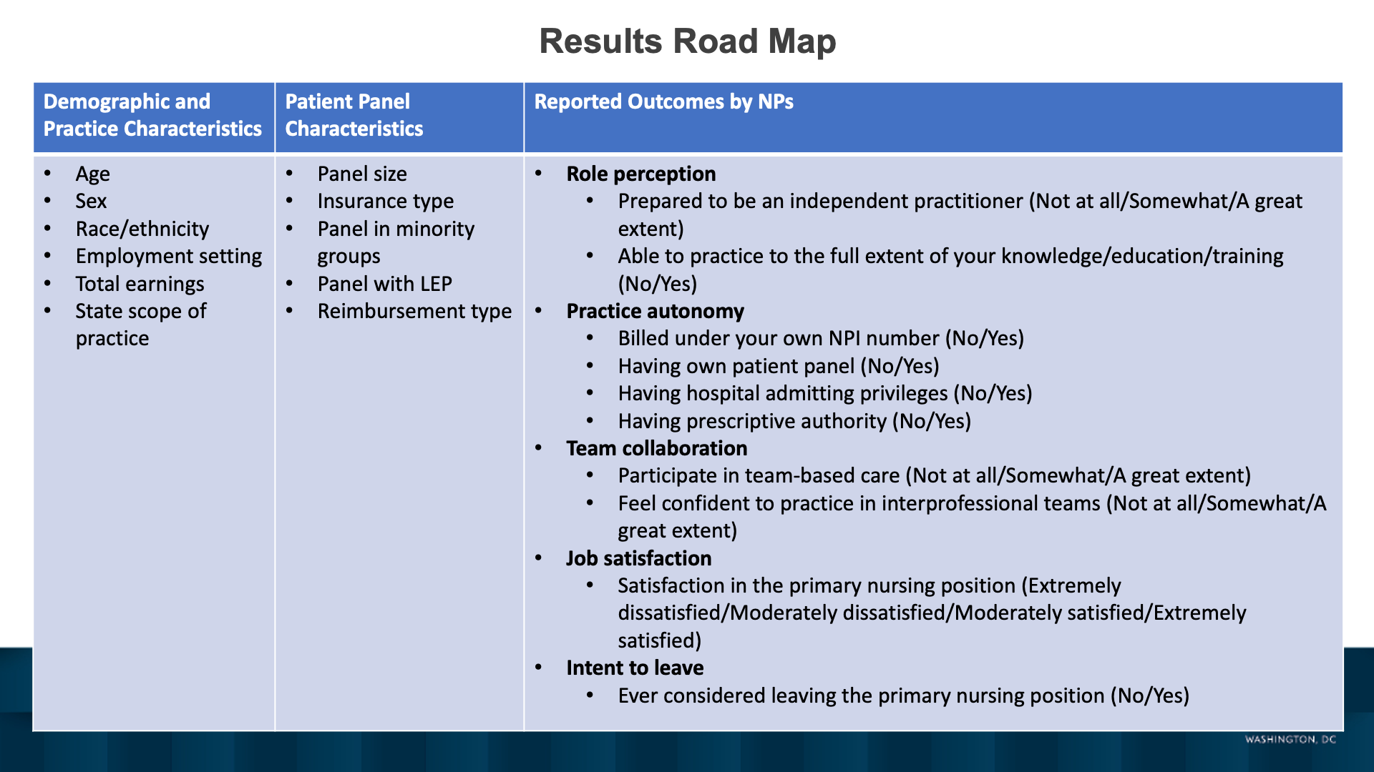
Results Road Map
Demographic and Practice Characteristics | Patient Panel Characteristics | Reported Outcomes by NPs
Age Sex Race/ethnicity Employment setting Total earnings State scope of practice | Panel size Insurance type Panel in minority groups Panel with LEP Reimbursement type | Role perception Prepared to be an independent practitioner (Not at all/Somewhat/A great extent) Able to practice to the full extent of your knowledge/education/training (No/Yes) Practice autonomy Billed under your own NPI number (No/Yes) Having own patient panel (No/Yes) Having hospital admitting privileges (No/Yes) Having prescriptive authority (No/Yes) Team collaboration Participate in team-based care (Not at all/Somewhat/A great extent) Feel confident to practice in interprofessional teams (Not at all/Somewhat/A great extent) Job satisfaction Satisfaction in the primary nursing position (Extremely dissatisfied/Moderately dissatisfied/Moderately satisfied/Extremely satisfied) Intent to leave Ever considered leaving the primary nursing position (No/Yes)

Slide 20
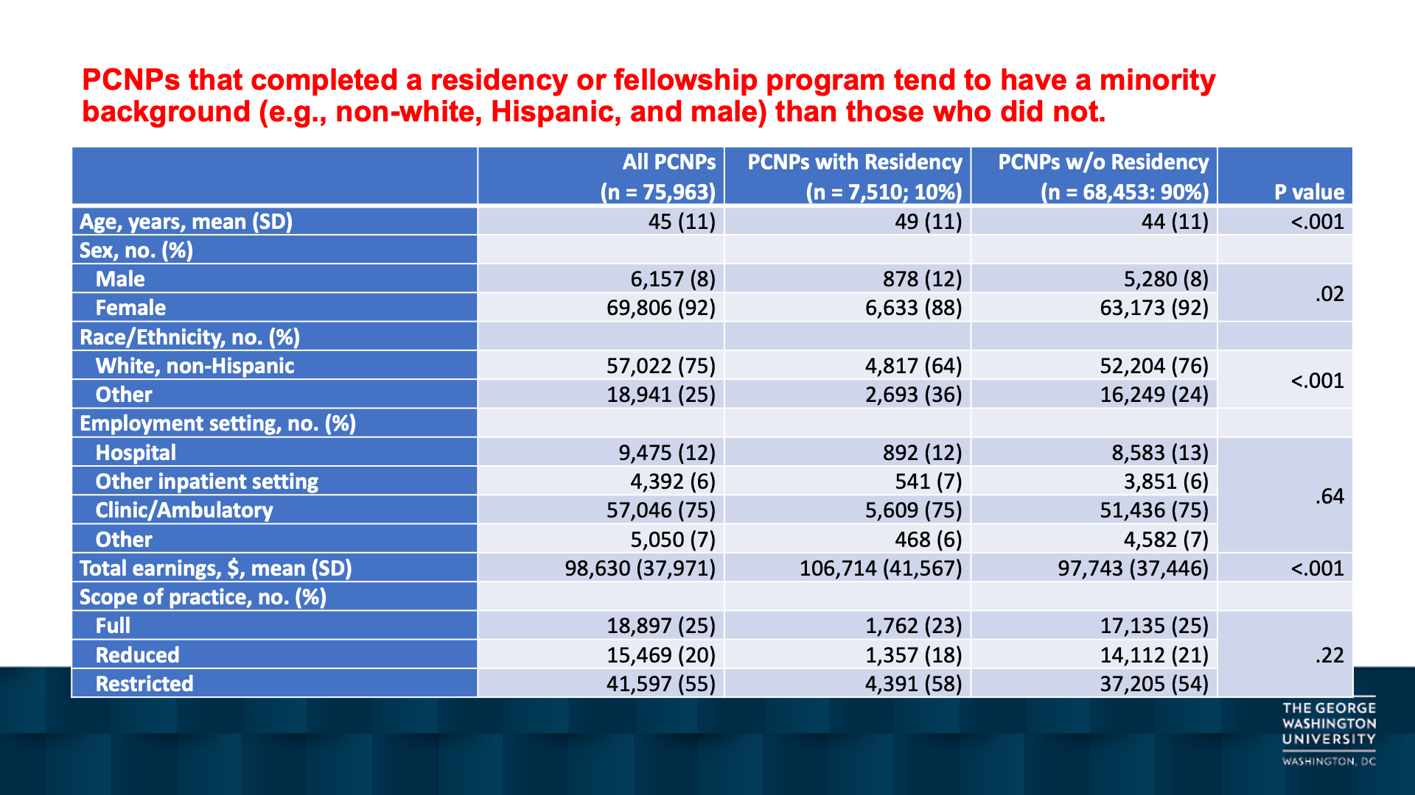
PCNPs that completed a residency or fellowship program tend to have a minority background (e.g., non-white, Hispanic, and male) than those who did not.
 | All PCNPs (n = 75,963) | PCNPs with Residency (n = 7,510; 10%) | PCNPs w/o Residency (n = 68,453: 90%) | P value
Age, years, mean (SD) | 45 (11) | 49 (11) | 44 (11) | <.001
Sex, no. (%)
Male | 6,157 (8) | 878 (12) | 5,280 (8) | .02
Female | 69,806 (92) | 6,633 (88) | 63,173 (92)
Race/Ethnicity, no. (%)
White, non-Hispanic | 57,022 (75) | 4,817 (64) | 52,204 (76) | <.001
Other | 18,941 (25) | 2,693 (36) | 16,249 (24)
Employment setting, no. (%)
Hospital | 9,475 (12) | 892 (12) | 8,583 (13) | .64
Other inpatient setting | 4,392 (6) | 541 (7) | 3,851 (6)
Clinic/Ambulatory | 57,046 (75) | 5,609 (75) | 51,436 (75)
Other | 5,050 (7) | 468 (6) | 4,582 (7)
Total earnings, $, mean (SD) | 98,630 (37,971) | 106,714 (41,567) | 97,743 (37,446) | <.001
Scope of practice, no. (%)
Full | 18,897 (25) | 1,762 (23) | 17,135 (25) | .22
Reduced | 15,469 (20) | 1,357 (18) | 14,112 (21)
Restricted | 41,597 (55) | 4,391 (58) | 37,205 (54)

Slide 21
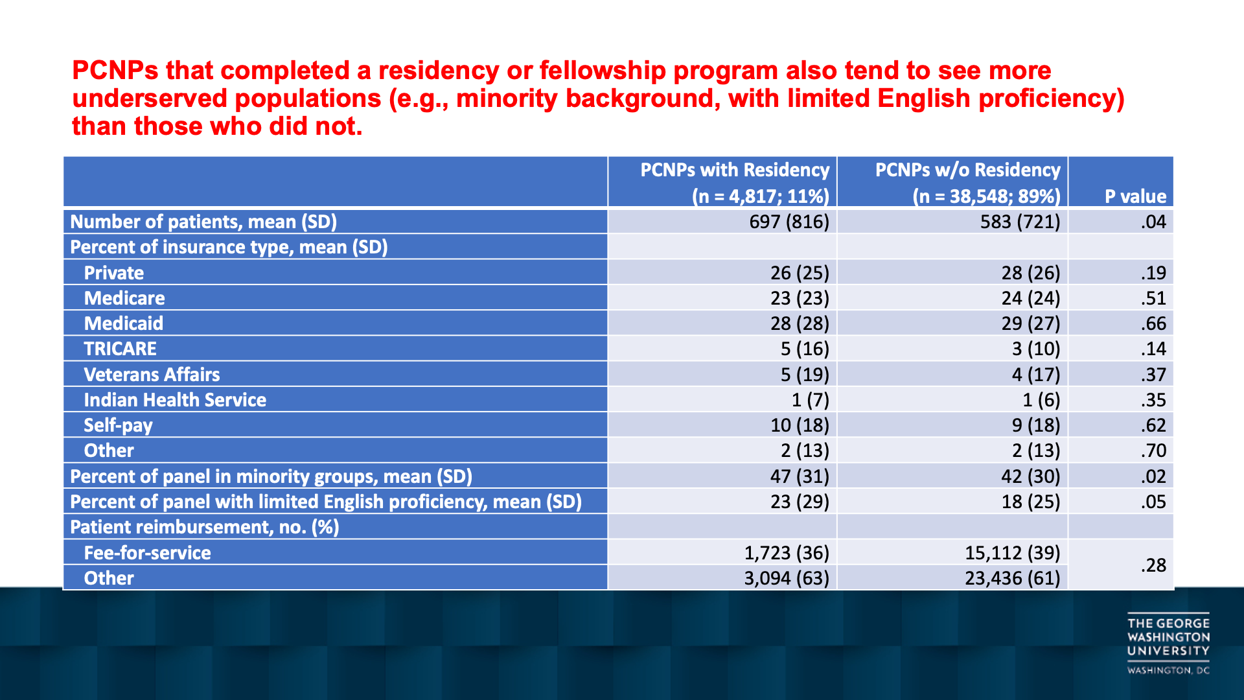
PCNPs that completed a residency or fellowship program also tend to see more underserved populations (e.g., minority background, with limited English proficiency) than those who did not.
 | PCNPs with Residency (n = 4,817; 11%) | PCNPs w/o Residency (n = 38,548; 89%) | P value
Number of patients, mean (SD) | 697 (816) | 583 (721) | .04
Percent of insurance type, mean (SD)
Private | 26 (25) | 28 (26) | .19
Medicare | 23 (23) | 24 (24) | .51
Medicaid | 28 (28) | 29 (27) | .66
TRICARE | 5 (16) | 3 (10) | .14
Veterans Affairs | 5 (19) | 4 (17) | .37
Indian Health Service | 1 (7) | 1 (6) | .35
Self-pay | 10 (18) | 9 (18) | .62
Other | 2 (13) | 2 (13) | .70
Percent of panel in minority groups, mean (SD) | 47 (31) | 42 (30) | .02
Percent of panel with limited English proficiency, mean (SD) | 23 (29) | 18 (25) | .05
Patient reimbursement, no. (%)
Fee-for-service | 1,723 (36) | 15,112 (39) | .28
Other | 3,094 (63) | 23,436 (61)

Slide 22
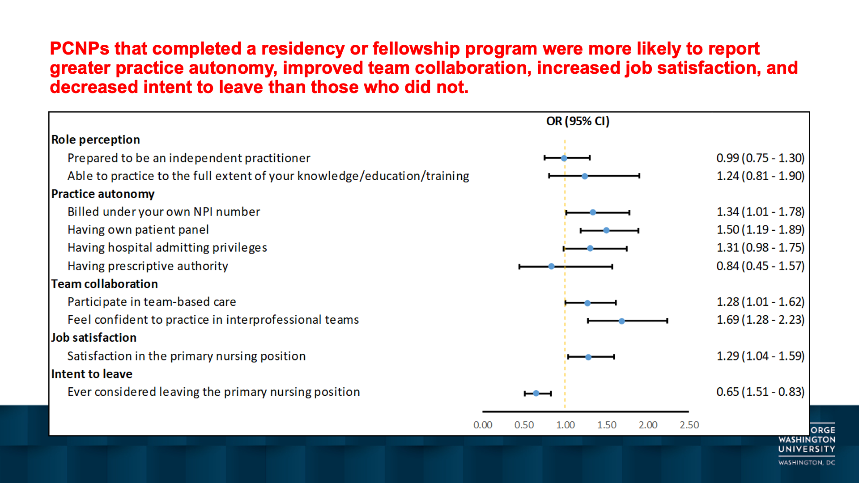
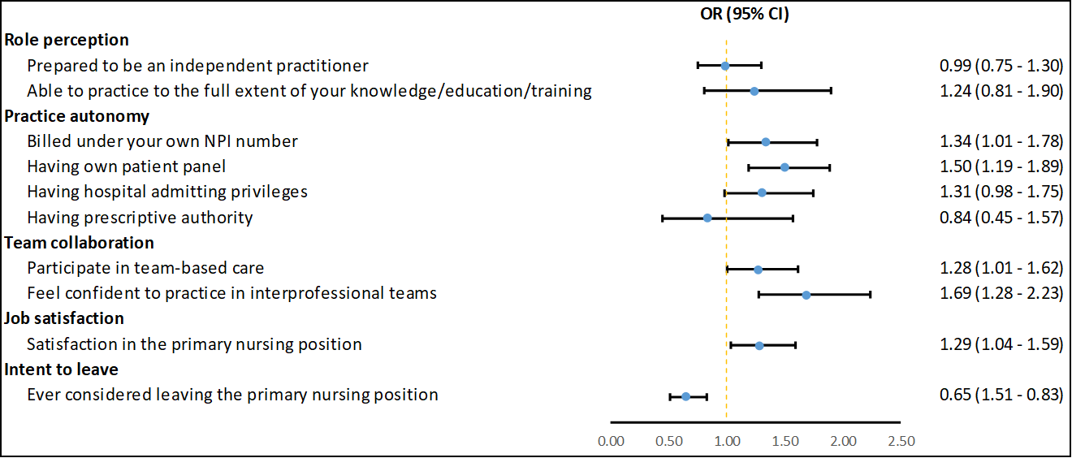
PCNPs that completed a residency or fellowship program were more likely to report greater practice autonomy, improved team collaboration, increased job satisfaction, and decreased intent to leave than those who did not.

Slide 23
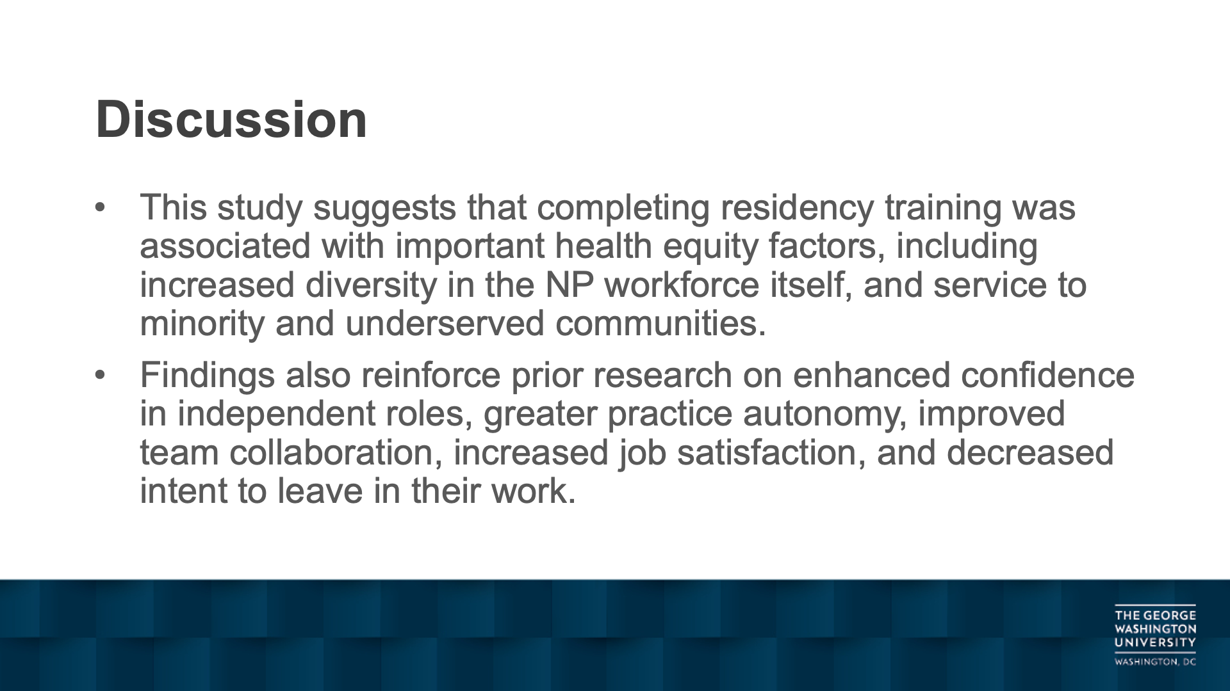
Discussion
This study suggests that completing residency training was associated with important health equity factors, including increased diversity in the NP workforce itself, and service to minority and underserved communities.
Findings also reinforce prior research on enhanced confidence in independent roles, greater practice autonomy, improved team collaboration, increased job satisfaction, and decreased intent to leave in their work.

Slide 24
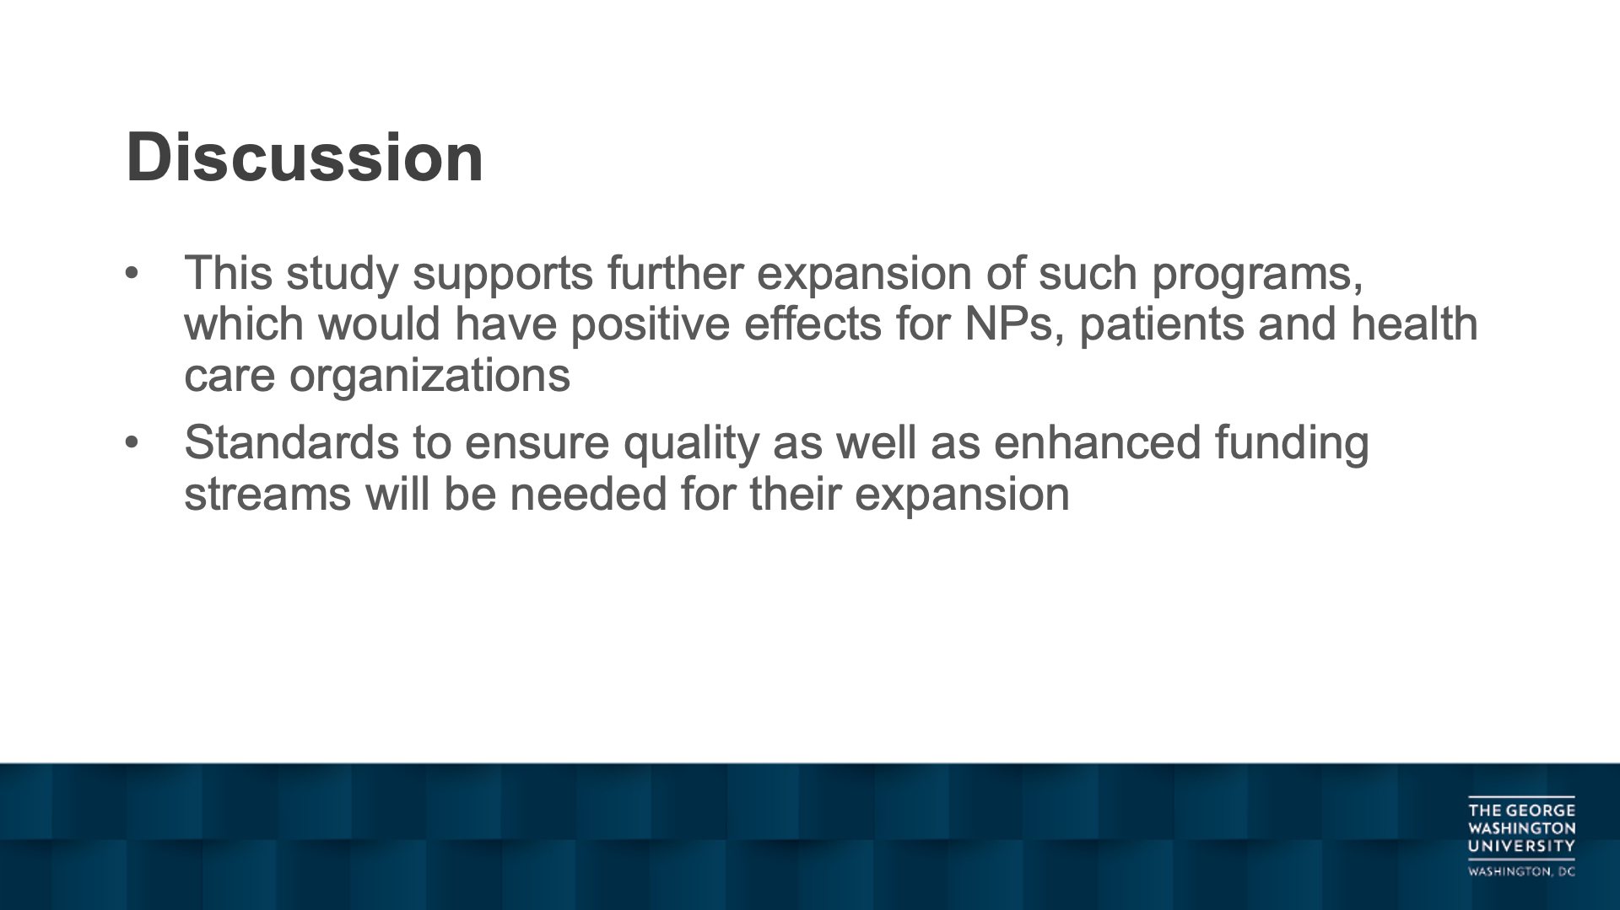
Discussion
This study supports further expansion of such programs, which would have positive effects for NPs, patients and health care organizations
Standards to ensure quality as well as enhanced funding streams will be needed for their expansion

Slide 25
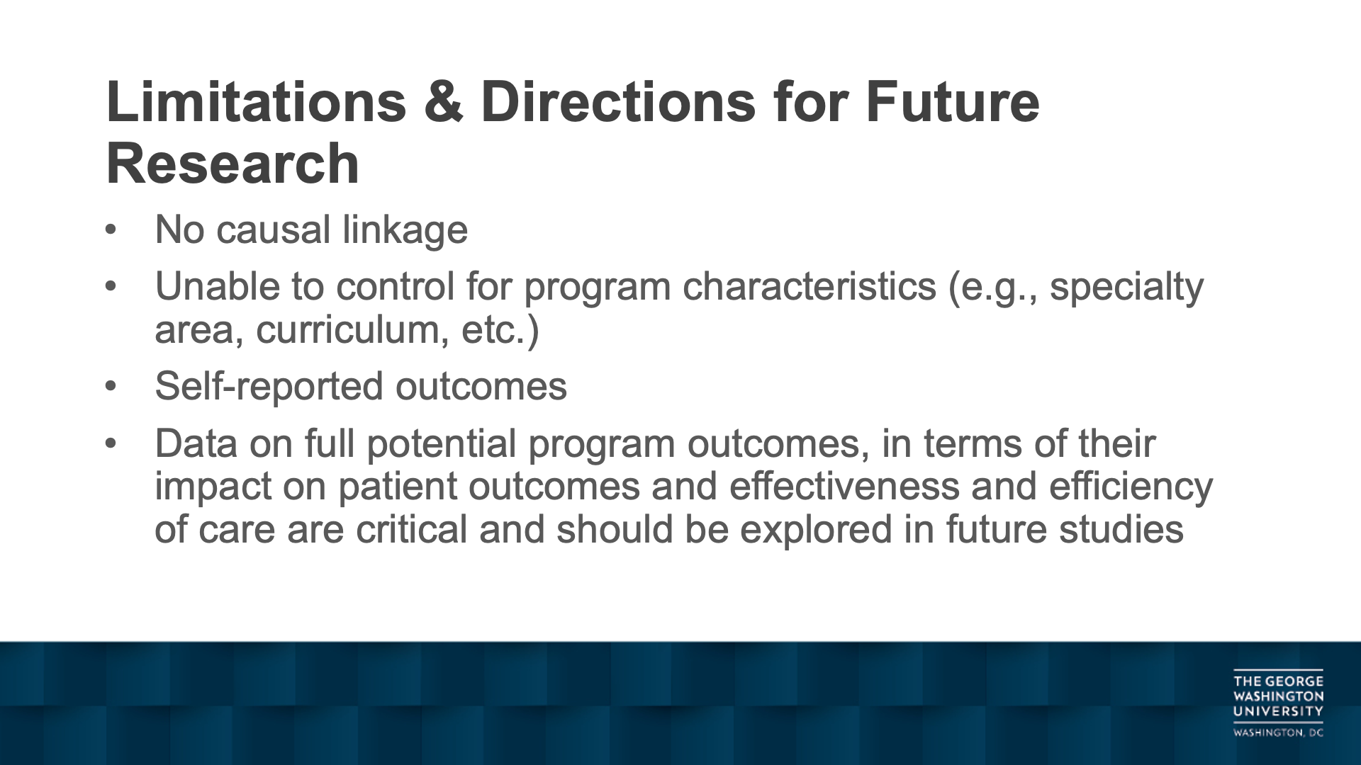
Limitations & Directions for Future Research
No causal linkage
Unable to control for program characteristics (e.g., specialty area, curriculum, etc.)
Self-reported outcomes
Data on full potential program outcomes, in terms of their impact on patient outcomes and effectiveness and efficiency of care are critical and should be explored in future studies

